Slide 1
Paediatric Respiratory Cases
GP lecture , FEB 2015
Sarah Denniston
– paediatric consultant, HEFT

Slide 2
Overview
Asthma
Wet cough is NOT asthma (case 1-4)
All that wheezes is NOT asthma
What IS asthma?
NOT all DRY cough is asthma
DDx and assessment of stridor (case 5)

Slide 3
Asthma
Wet cough is NOT asthma
All that wheezes is NOT asthma

Slide 4
Case 1
12 year old Pakistani boy with cough and wheeze
Treatment: seretide 50 two puffs bd, salbutamol prn
Poor response
OPA 1: montelukast added
OPA 2: improved control, but poor cough technique – referred physio
Physio review: WET cough – please reconsider diagnosis

Slide 5
Case 1
Grommets inserted twice but extruded
Hearing aids for conductive hearing loss
WET cough
No clubbing, no crackles, hyperinflated chest

Slide 6
Case 1 = Primary Ciliary Dyskinesia
Grommets inserted twice but extruded
Hearing aids for conductive hearing loss
WET cough
No clubbing, no crackles, hyperinflated chest

Slide 7
Case 2
8 year old girl
beclomethasone 50mcg two puffs twice daily
Montelukast
Long history discharging ears. Awaiting mastoidectomy
WET cough

Slide 8
Case 2 = Primary ciliary Dykinesia
8 year old girl
beclomethasone 50mcg two puffs twice daily
Montelukast
Long history discharging ears. Awaiting mastoidectomy
WET cough

Slide 9
Case 3
Infant with situs inversus and neonatal pneumonia
Two sibs – 12 year brother has asthma…
WET cough

Slide 10
Primary Ciliary Dyskinesia
Rare, AR or de novo
Higher rate in Pakistan
Nose, Ears, Chest
Diagnosis
clinical suspicion
End nasal NO
Ciliary biopsy
Genetic testing

Slide 11
Case 4:
5 yr 8 mths.
Recurrent cough and wheeze.
On beclomethasone 200mcg bd and
Salbutamol PRN
Height and weight 0.4th centile.
Clubbed, scattered crackles.

Slide 12
Notes:
Smaller than brother younger by 2 years
Born just prior to introduction of CF screening
Would love to say he is much better but actually requiring very intensive management

Slide 13
DIAGNOSIS
5 yr 8 mths
(born May 2007)
Recurrent WET cough and wheeze.

Slide 14
DIAGNOSIS = Cystic Fibrosis
5 yr 8 mths
(born May 2007)
Recurrent WET cough and wheeze.

Slide 15
Cystic Fibrosis
Screening by IRT on new born heel prick sample
Introduced Autumn 2007
This child also had delayed meconium, distended abdo, rectal prolapse, poor growth, and WET cough

Slide 16
All wheeze is
not asthma

Slide 17
WET cough is
NOT asthma

Slide 18
BUT! What about….
Viral induced wheeze?
Viral exacerbations of asthma?
Bronchodilators and steroids can be targeted at DRY cough and associated wheeze
Wheeze with WET cough is likely due to secretions.

Slide 19
WET cough is
NOT asthma

Slide 20
Asthma
What IS asthma?
NOT all dry cough is asthma

Slide 21
Chronic cough BTS
Notes:
More than 8 weeks
Initial assessment history, examination, CXR, spirometry

Slide 22
What IS asthma?
Asthma = episodic reversible airways narrowing characterised by wheeze and DRY cough with bronchoconstriction and inflammation.
BTS/Sign 2008: Central to all definitions is the presence of symptoms (more than one of wheeze, breathlessness, chest tightness, cough) and of variable airflow obstruction. More recent descriptions of asthma in children and in adults have included airway hyper-responsiveness and airway inflammation as components of the disease.

Slide 23
PIAMA - Netherlands
PIAMA Predictor variable |  | Before validation, OR (95% CI) | After validation, OR (95% CI) | Points in prediction score‖
1 | Male sex | 1.7 (1.3-2.3) | 1.6 (1.2-2.1) | 4.6
2 | Postterm delivery | 2.3 (1.3-4.0) | 2.1 (1.2-3.6) | 7.3
3 | Medium/low parental education | 1.6 (1.1-2.3) | 1.5 (1.1-2.2) | 4.2
4 | Inhalation medication, parent(s) | 2.4 (1.8-3.3) | 2.2 (1.6-3.0) | 7.7
5 | Wheezing frequency†
 | 1-3 times/y | 1.6 (1.1-2.3) | 1.5 (1.1-2.1) | 4.2
 | ≥4 times/y | 2.8 (1.9-4.2) | 2.5 (1.7-3.6) | 9.1
6 | Wheezing/dyspnea apart from colds‡ | 2.3 (1.3-4.1) | 2.0 (1.1-3.7) | 7.1
7 | Serious infections†
 | 1-2 times/y | 1.7 (1.3-2.2) | 1.6 (1.2-2.1) | 4.6
 | ≥3 times/y | 2.2 (1.4-3.3) | 2.0 (1.3-3.0) | 6.9
8 | Doctor's diagnosis of eczema and eczematous rash | 2.6 (1.9-3.5) | 2.3 (1.7-3.1) | 8.2 +
C-index |  | 0.743 | 0.717 | 55.1A

Slide 24
API
Primary | Early frequent wheezer (≥3 on 1–5 rating scale) |  | Asthma Predictive Index
AND
Secondary | At least 1 major: | OR | At least 2 minor:
 | Parental physician-diagnosed asthma |  | Wheezing unrelated to colds
 | Physician-diagnosed atopic dermatitis |  | Eosinophils ≥4% in circulation
 |  |  | Physician-diagnosed allergic rhinitis
mAPI
Primary | ≥4 wheezing episodes in a year
AND
Secondary | At least 1 major: | OR | At least 2 minor:
 | Parental physician-diagnosed asthma |  | Wheezing unrelated to colds
 | Physician-diagnosed atopic dermatitis |  | Eosinophils ≥4% in circulation
 | Allergic sensitization to at least one aeroallergen |  | Allergic sensitization to milk, egg, or peanuts

Slide 25
DRY Chronic cough
Notes:
More than 8 weeks
Initial assessment history, examination, CXR, spirometry

Slide 26
DRY Chronic cough
Notes:
More than 8 weeks
Initial assessment history, examination, CXR, spirometry

Slide 27
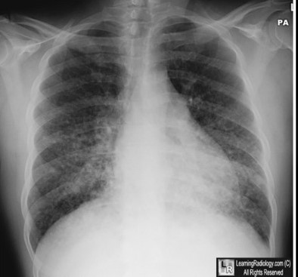
DRY Chronic cough
Notes:
More than 8 weeks
Initial assessment history, examination, CXR, spirometry

Slide 28
Isolated cough –
cough variant asthma?

Slide 29
Isolated DRY cough – cough variant asthma?
Does it exist?
Some say ‘yes’
Cough variant asthma is a common problem ...that frequently goes unrecognized...
Spirometry is often within normal limits.
Any patient with a nonproductive, nocturnal cough lasting more than two weeks, should receive an empiric trial of bronchodilators.
The natural history of cough variant asthma is variable. A significant proportion develop the classic signs and symptoms of asthma, whereas for many , cough resolves without need for further treatment.
Cough variant asthma: a review of the clinical literature.
Johnson D, Osborn LM. J Pediatr. 1989 Nov;115(5 Pt 2):856-62.

Slide 30
Cough variant asthma
And some say ‘no’
In children with isolated chronic cough there was
no difference between salbutamol and placebo group. Tomerak AA, Vyas H, Lakenpaul M, McGlashan JJ, McKean M.
Cochrane Database Syst Rev. 2005 Jul 20;(3):CD005373. Review.
J Asthma. 1991;28(2):85-90.
Inhaled steroids - with the lower dose ... there was no significant difference... With the higher dose there was a significant improvement in nocturnal cough frequency .... However, a significant but smaller improvement was also seen with placebo.
Tomerak AA, McGlashan JJ, Vyas HH, McKean MC.
Cochrane Database Syst Rev. 2005 Oct 19;(4):CD004231. Review.

Slide 31
Cough variant asthma
Clinical bottom line:
It is important not to over-diagnose asthma in children who in fact have a chronic non-specific cough. Such children require no treatment, get better with time, and have normal long-term lung function.

Slide 32
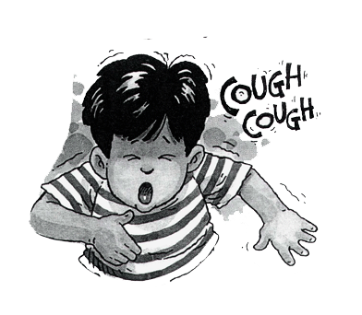
Chronic cough
Chronic Cough (BTS)
Notes:
Is it troublesome?
Normal children may cough up to 30 times a day (av 11 X)

Slide 33
Chronic cough
Chronic Cough (BTS)
Notes:
Is it troublesome?
Normal children may cough up to 30 times a day (av 11 X)

Slide 34
Chronic cough
Chronic Cough (BTS)
Notes:
Is it troublesome?
Normal children may cough up to 30 times a day (av 11 X)

Slide 35
Chronic cough
Chronic Cough (BTS)
Notes:
Is it troublesome?
Normal children may cough up to 30 times a day (av 11 X)

Slide 36
Asthma
Wet cough is NOT asthma
All that wheezes is NOT asthma
All dry cough is NOT asthma

Slide 38
INFANTILE STRIDOR - case
4 month infant
Pregnancy and birth unremarkable
Stridor shortly after birth
2/12: Attended with vomiting
– Dx: reflux; Rx: ranitidine
2.5/12: bronchiolitis (flu A)
3 weeks later: static growth, respiratory distress at rest with stridor admitted for Ix and surgery

Slide 39
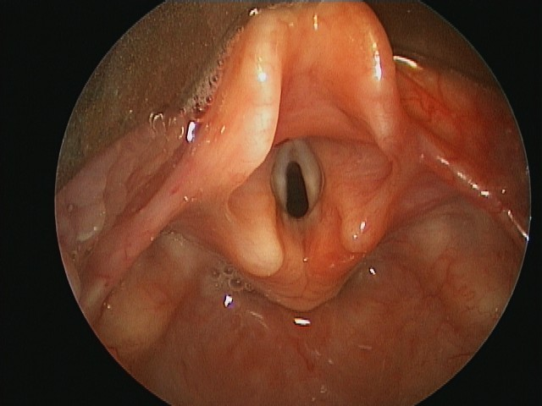
Severe laryngomalacia

Slide 40
Laryngomalacia
75% of infantile stridor
Mostly mild, worse prone, and on crying. Normal voice.
May initially worsen
Resolves by age 2 and often earlier
Treatment:
none
calorie fortification
Treat acid reflux
Surgical intervention

Slide 41
Differential diagnosis includes:
Vocal cord palsy (unilateral)
Laryngeal web
Subglottic stenosis
Cysts, haemangiomas, papillomas
Tracheomalacia – expiratory stridor
External compression from
vascular ring
cystic lung lesion
CNS lesions with increased tone

Slide 42
Wide differential diagnosis

Slide 43
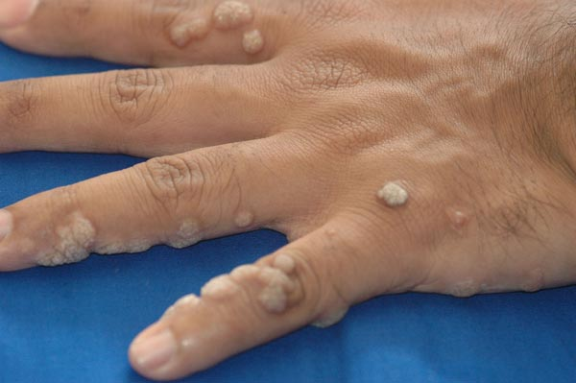
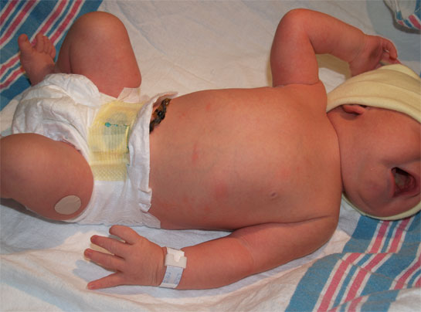
Clues in history

Slide 44
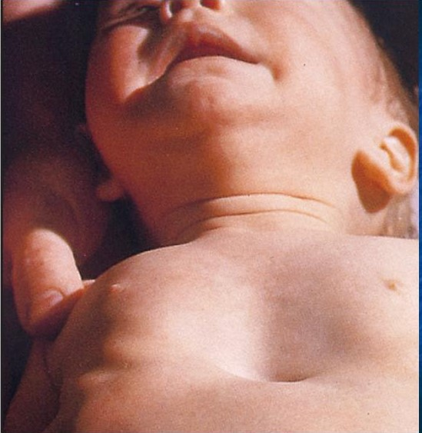
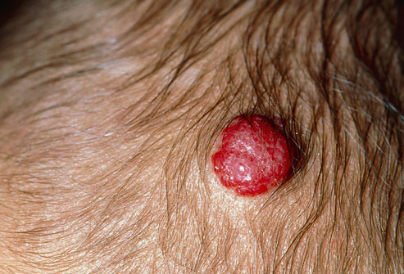
Clues on examination

Slide 45
Vocal cord palsy
Unilateral
Increased risk with cardiac surgery, birth trauma (eg Erbs palsy), or congenital
Hoarse or quiet voice
Biphasic stridor, improved lying on affected side, worse awake
Often resolves spontaneously by age 2
Refer ENT

Slide 46
Laryngeal web, subglottic stenosis
Biphasic stridor
Stenosis increased by prolonged intubation, may present late.
Urgency of referral depends on respiratory distress and growth

Slide 47
Laryngeal cyst, haematoma, papilloma
Rare
Haematoma – may have other ‘strawberry naevi’
Papilloma – rare history of genital warts

Slide 48
Tracheal stenosis or malacia
Expiratory stridor – often confused with wheeze
Prolonged expiratory phase
May be caused by vascular rings eg double aortic arch

Slide 49
Clinical Bottom Line
Refer if:
Failing to thrive
Significant respiratory distress
Progressive
Biphasic or expiratory stridor
Weak cry or hoarse voice
Haemangioma, maternal genital warts, cardiac signs/recurrent chest infection
History of prolonged intubation, erbs palsy or traumatic delivery

Slide 50
Thank you for listening.
Any questions?

Slide 51
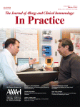
References
J Allergy and Clinical immunology. November 2009Volume 124, Issue 5, Pages 903–910.e7
Predicting the long-term prognosis of children with symptoms suggestive of asthma at preschool age
Daan Caudri, MD, Alet Wijga, PhD, C. Maarten A. Schipper,
Current Opinion in Allergy and Clinical Immunology 2011, 11:157–161. The Asthma Predictive Index: early diagnosis of asthma Jose A. Castro-Rodriguez
The Journal of Allergy and Clinical Immunology: In Practice Volume 1, Issue 2, March 2013, Pages 152–156 Evaluation of the Modified Asthma Predictive Index in High-Risk Preschool Children Timothy S. Chang, PhDª, Robert F. Lemanske Jr., MD
Sign/ BTS guidelines – cough in children, asthma
UpTo Date

